Slide 1

UI/UX
TOPIC: Choose Any Issues in Lovely Professional University and give the Solution
Submitted By: Aaditya Raj Pandey
Registration No. 12114082
Submitted To: Ms. Maggie Banra
Teacher UID: 30480
GitHub : aaditya620321
2021-2025

Slide 2
Busy schedules and distant mess halls leave University hostel residents with missed meals, unhealthy alternatives, and wasted money.
PROBLEM STATEMENT

Slide 3
Current Situation
PROBLEM STATEMENT
Many university students residing in on-campus hostels face significant challenges accessing meals provided by the designated mess facilities. These challenges often stem from:
Time Constraints: Busy academic schedules, extracurricular activities, and part-time work commitments frequently clash with designated mess timings, leading to missed meals and dietary inconsistencies.
Inaccessibility: The physical distance between academic blocks and mess halls can be considerable, particularly for students with limited mobility or during inclement weather. This inaccessibility discourages meal utilization and fosters reliance on unhealthy alternatives.

Slide 4
Consequences: These challenges have detrimental consequences for students' well-being:
PROBLEM STATEMENT
Nutritional Deficiencies: Missed meals and reliance on unhealthy alternatives can compromise dietary intake and lead to nutritional deficiencies, impacting academic performance and overall health.
Financial Inefficiency: Students are forced to spend extra money on alternative meals, straining their budgets and compromising access to other necessities.

Slide 5
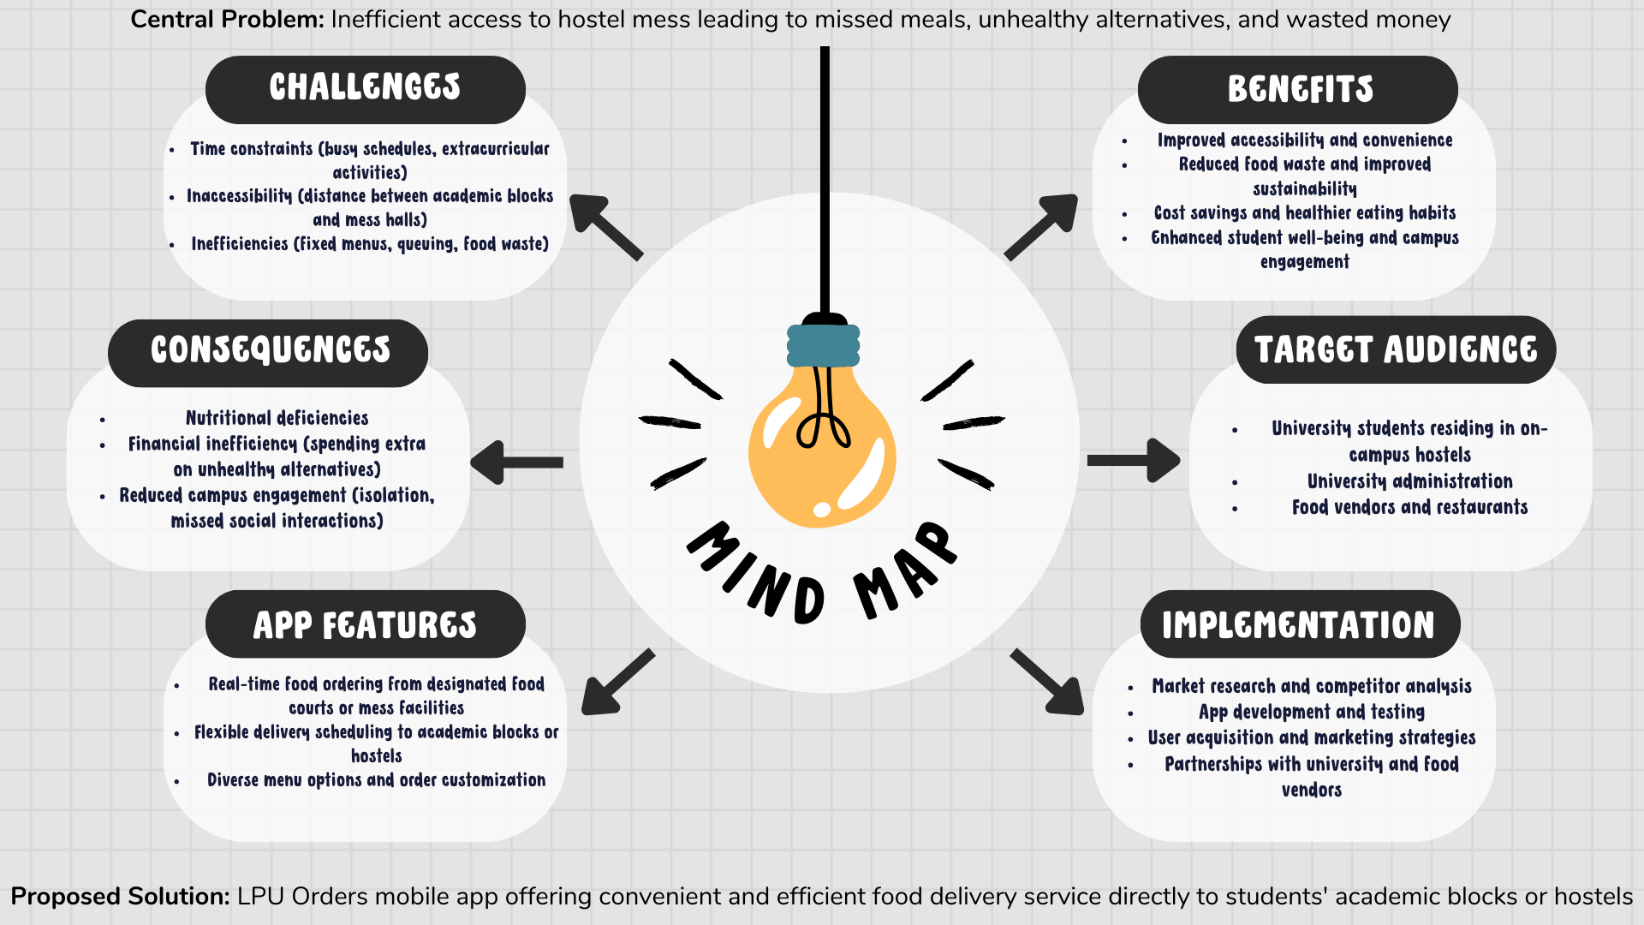
MIND MAPPING :
Proposed Solution: LPUGrub mobile app affering convenient and efficient food delivery service directly to students academic blocks or hostels

Slide 6
Case Study
LPUGrub : Bridging the Gap Between Busy Schedules and Nutritious Meals at Lovely Professional University.
Executive Summary:
LPU students residing in hostels often face challenges accessing the designated mess facilities during lunchtime due to busy
Schedules and long distances between academic blocks and hostels. This results in missed meals, reliance on unhealthy alternatives, and ultimately wasted money and compromised well-being. LPUGrub, a novel in-campus food delivery app, addresses these issues by providing a convenient and efficient solution for students to order meals directly to their academic blocks during designated break times.
The Problem:
Time Constraints: LPU students juggle demanding academic schedules and extracurricular activities often conflicting with fixed mess timings.
Inaccessibility: Significant distance between academic blocks and hostels discourages students from utilizing the mess facilities during breaks.
Inefficiency: Traditional mess systems offer fixed menus and require queuing, leading to food waste due to unappealing options or time constraints.

Slide 7
Case Study
The Solution:
Real-time food ordering: Students can conveniently order meals from designated food courts or mess facilities through the app during designated break times.
Flexible delivery scheduling: Orders are delivered directly to chosen academic blocks or hostels, eliminating the need for students to travel to the mess.
Order Customization: Students can personalize their orders, ensuring they receive meals that meet their specific needs and preferences.
Results and Impact:
Improved Accessibility and Convenience: Students can access nutritious meals even during busy schedules, promoting healthy eating habits.
Reduced Food Waste: Flexible ordering and customization options minimize food waste by reducing the likelihood of unwanted or unsuitable meals.
Cost Savings: Students avoid spending additional money on unhealthy alternatives due to missed meals or inconvenient access to the mess.

Slide 8
Case Study
Conclusion: LPUGrub demonstrates the power of innovative technology to address real-world challenges faced by students in university settings. By bridging the gap between busy schedules and healthy meals, the app has the potential to significantly improve the lives of LPU residents, contributing to a healthier and more vibrant campus community.
Next Steps:
Continuously improve the app functionality based on user feedback.
Explore partnerships with additional food vendors and restaurants.
Implement gamification elements to incentivize app usage and healthy eating habits.
Consider replicating the model at other universities facing similar challenges.
LPUGrub represent a promising solution for universities seeking to address student food accessibility and promote a healthier and more engaged campus environment. This case study highlights the app's potential to revolutionize how students access meals, optimize resource utilization, and ultimately, contribute to the well-being of the entire university community.

Slide 9
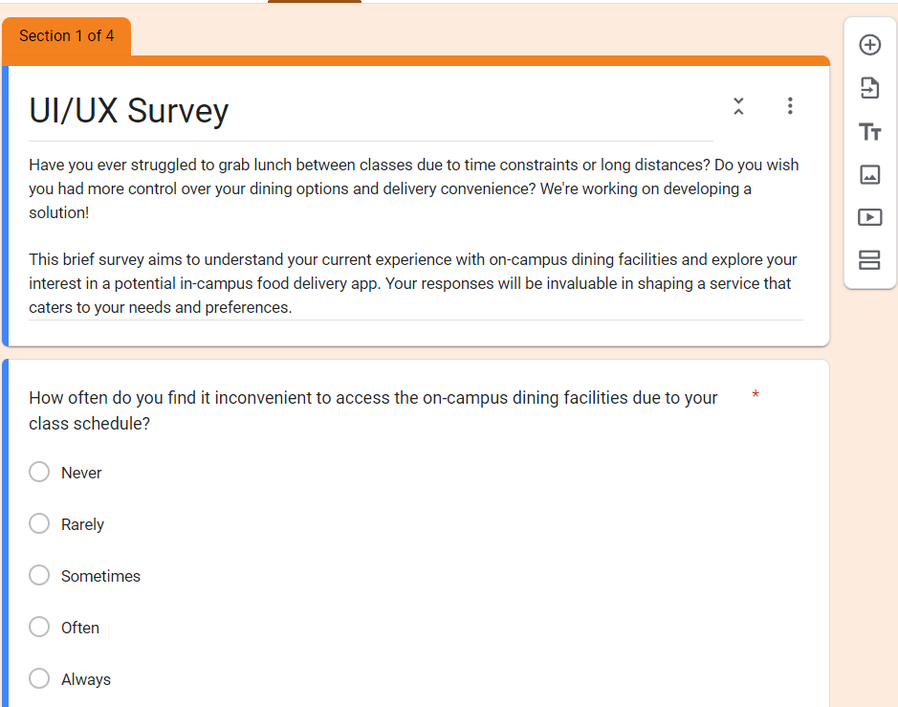
Online Survey:

Slide 10
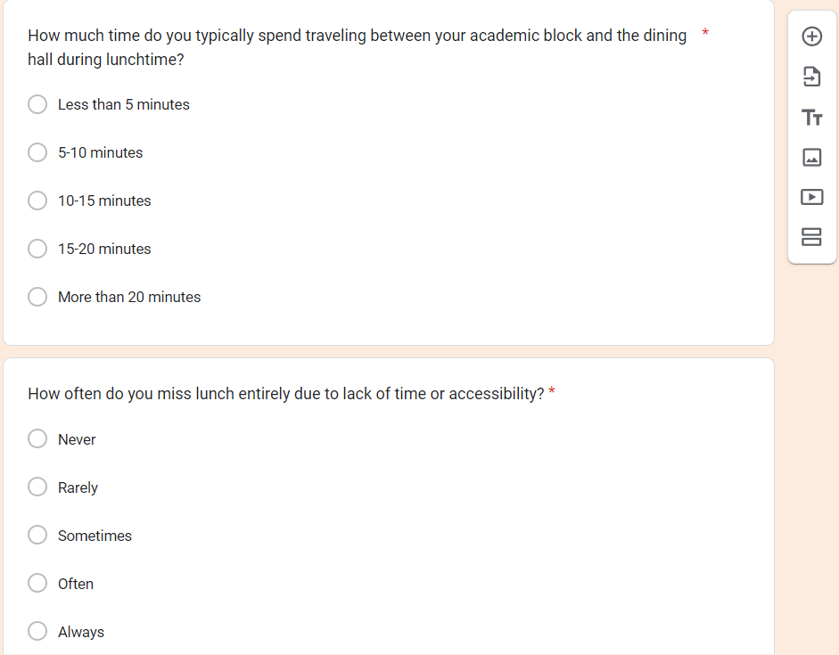
Online Survey:

Slide 11
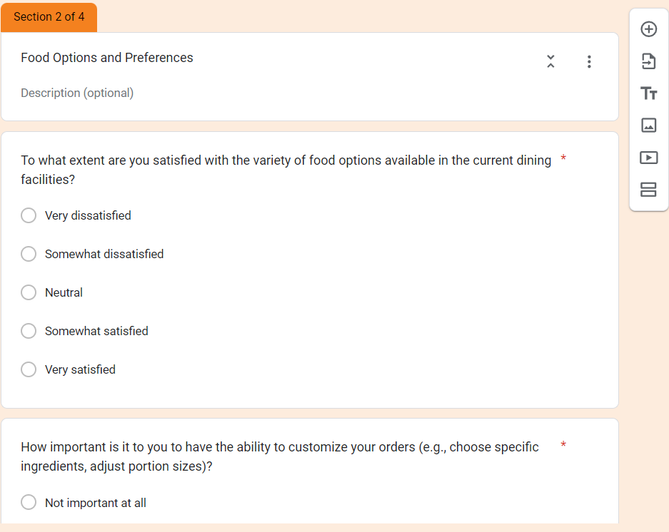
Online Survey:

Slide 12
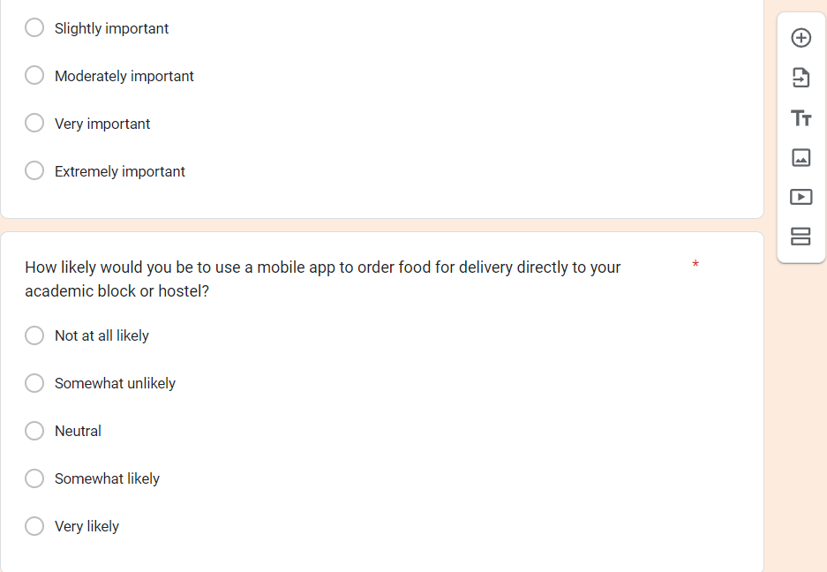
Online Survey:

Slide 13
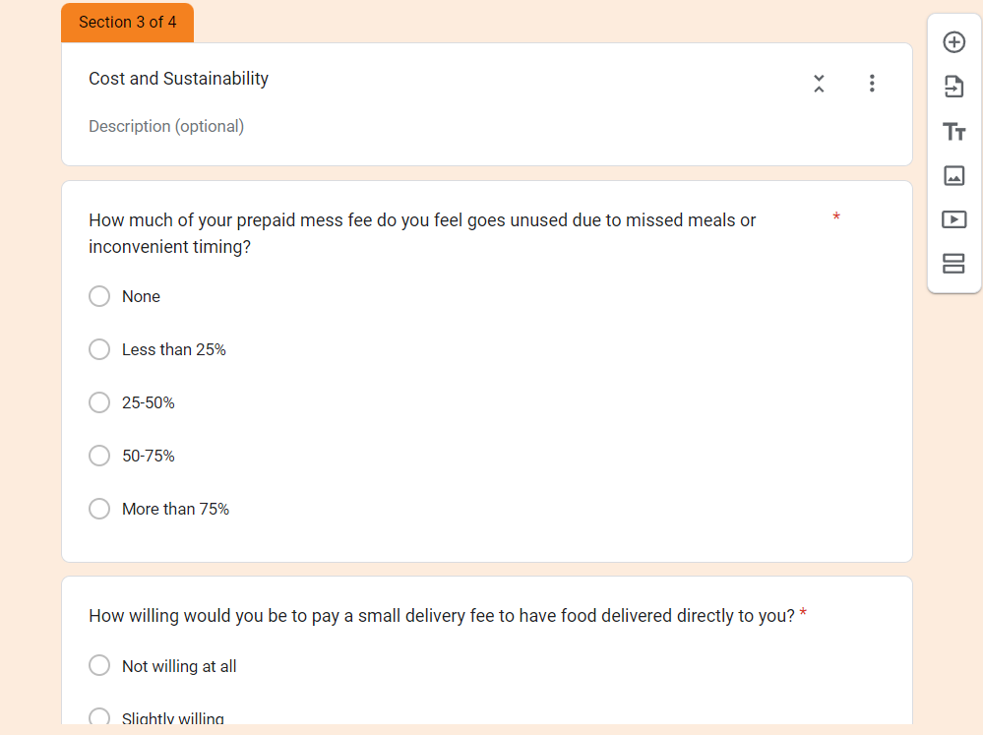
Online Survey:

Slide 14
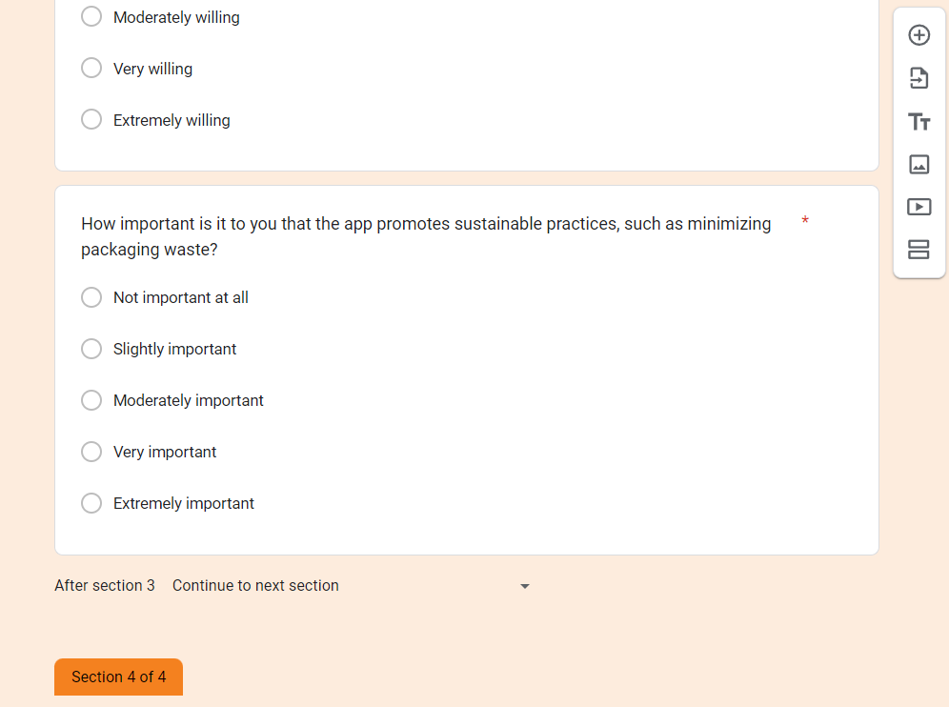
Online Survey:

Slide 15
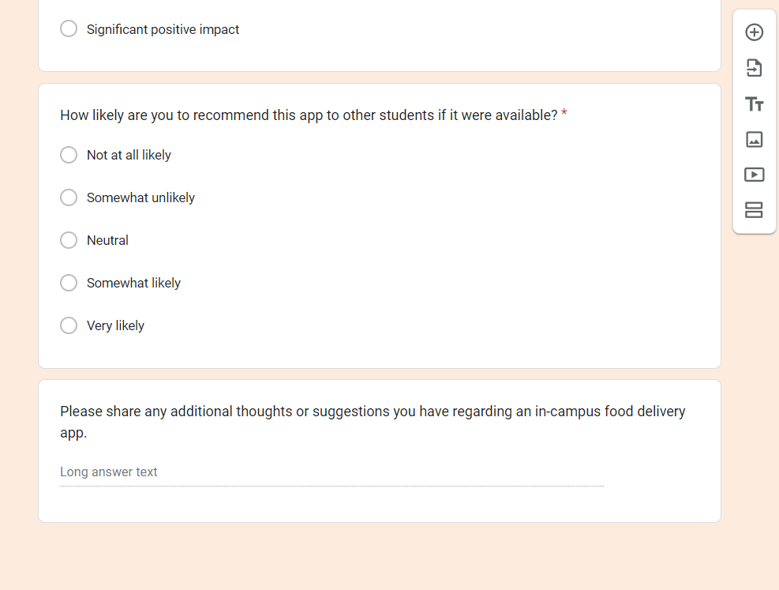
Online Survey:

Slide 16
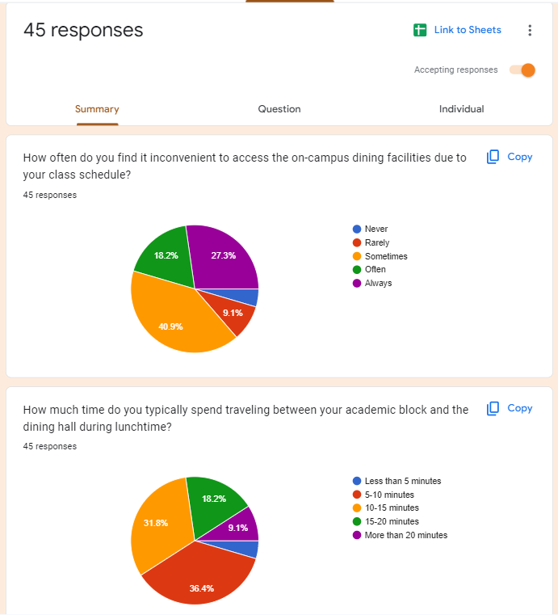
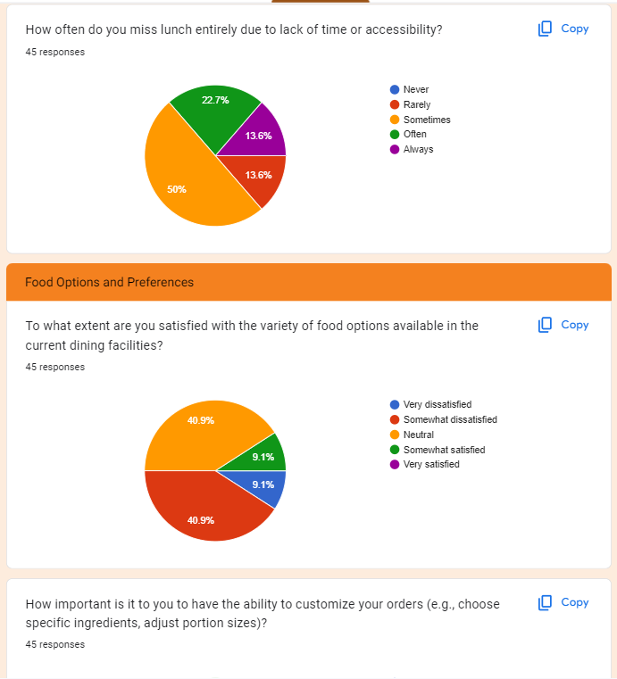
Online Survey

Slide 17
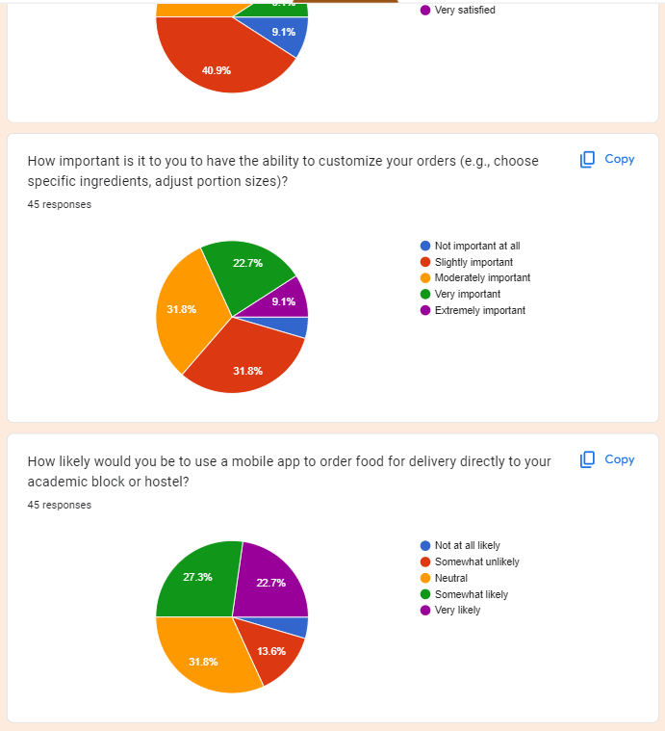
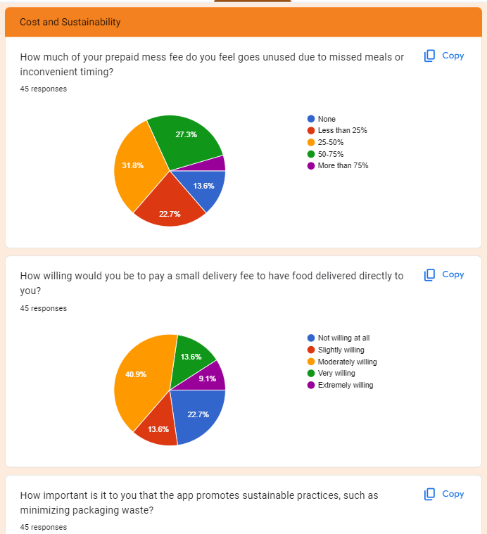
Online Survey

Slide 18
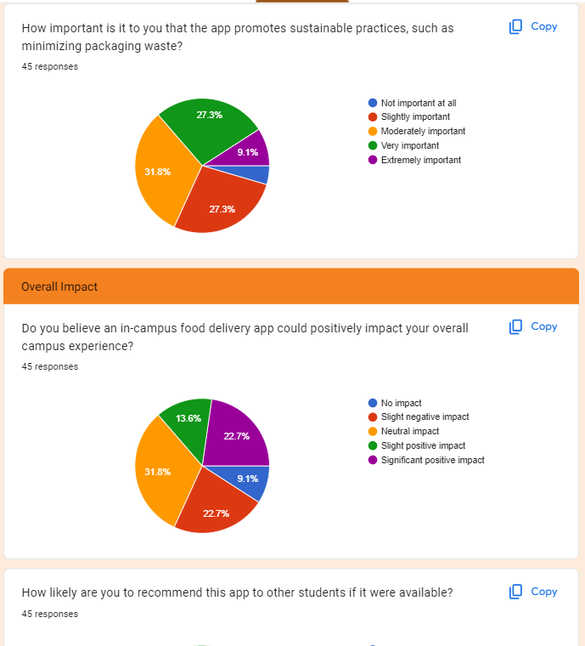
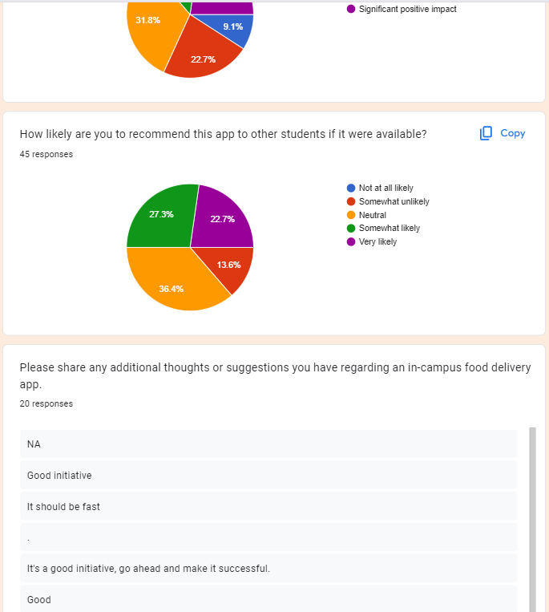
Online Survey

Slide 19
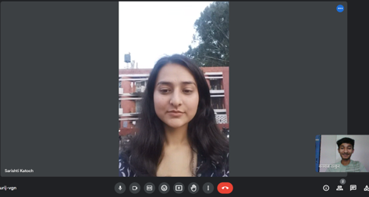
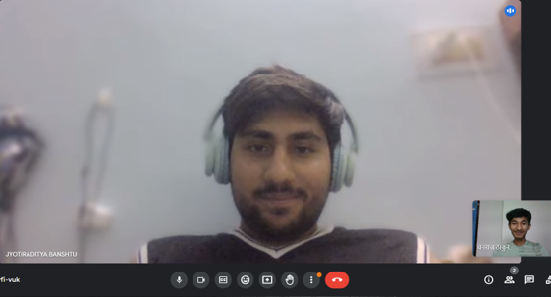
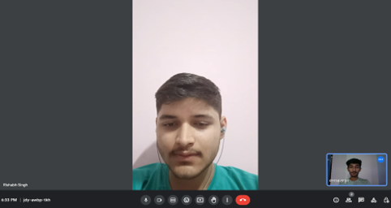
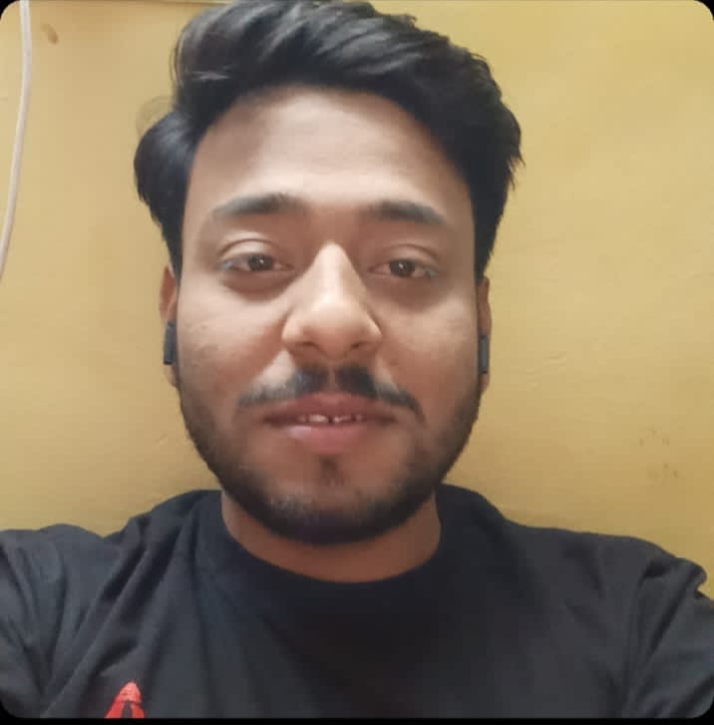
Interviews

Slide 20
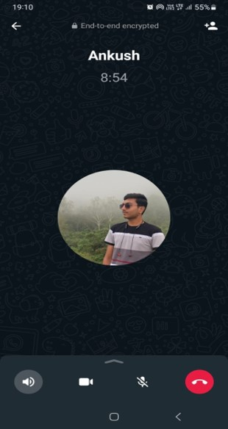
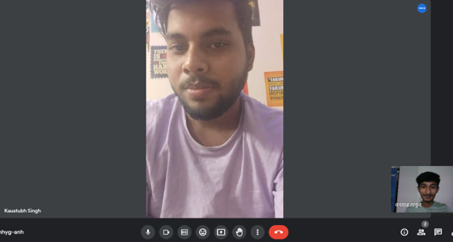
Interviews

Slide 21
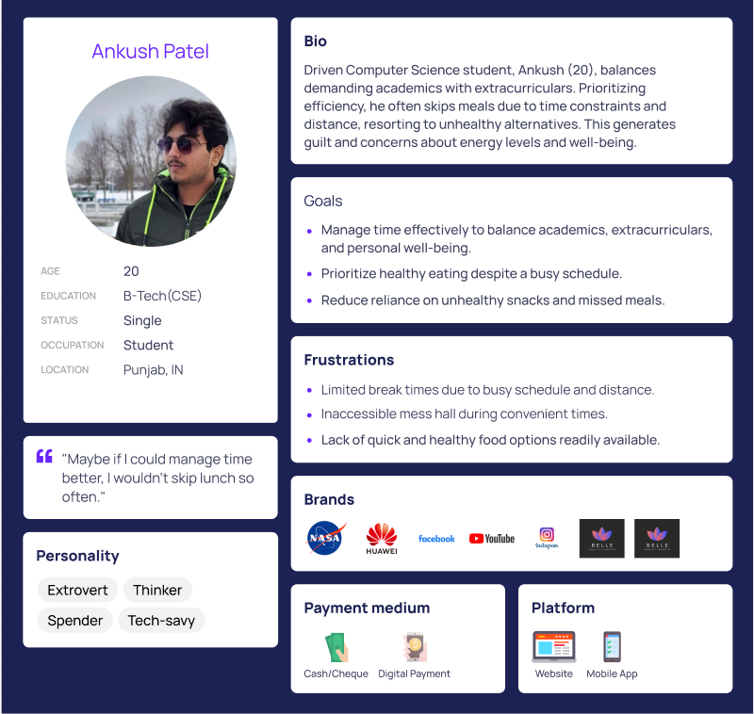
USER PERSONA

Slide 22
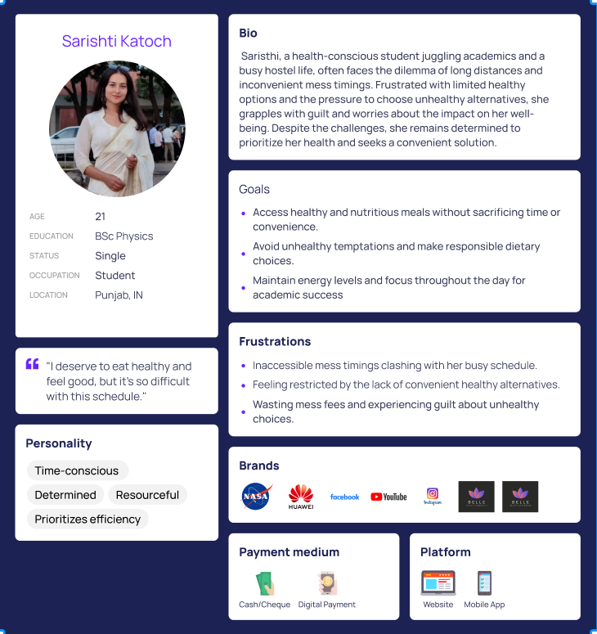
USER PERSONA

Slide 23
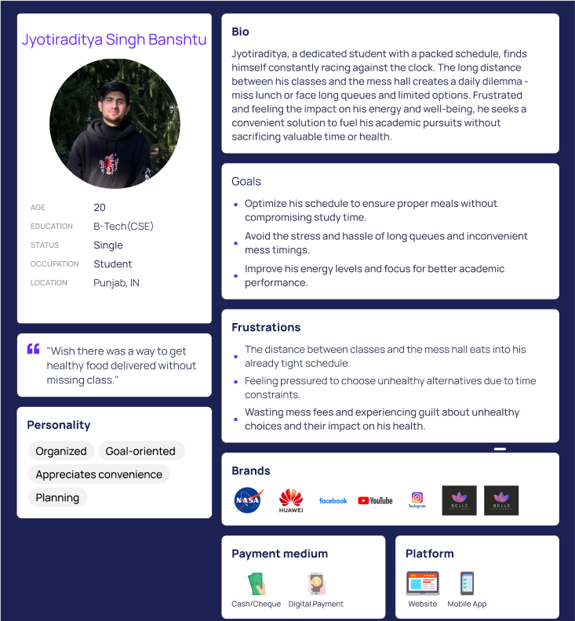
USER PERSONA

Slide 24
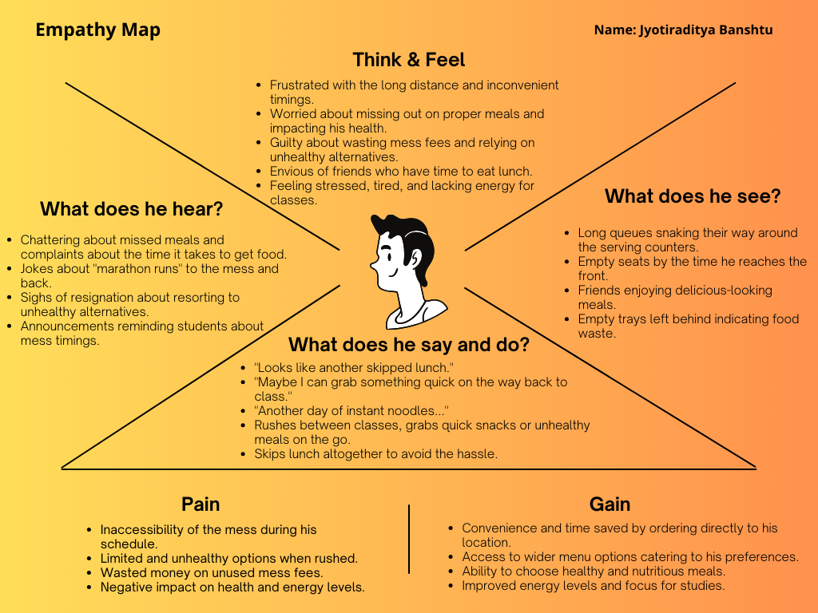
EMPATHY MAPPING

Slide 25
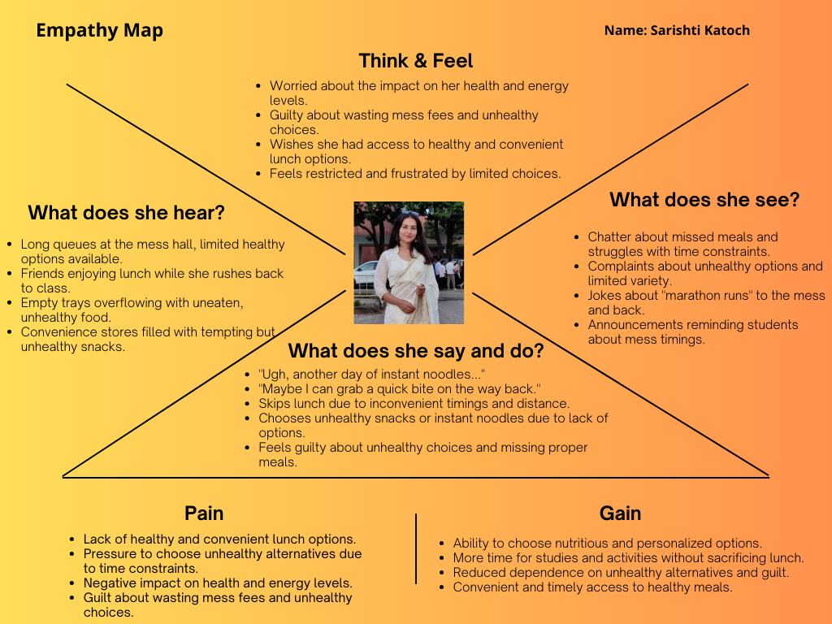
EMPATHY MAPPING

Slide 26
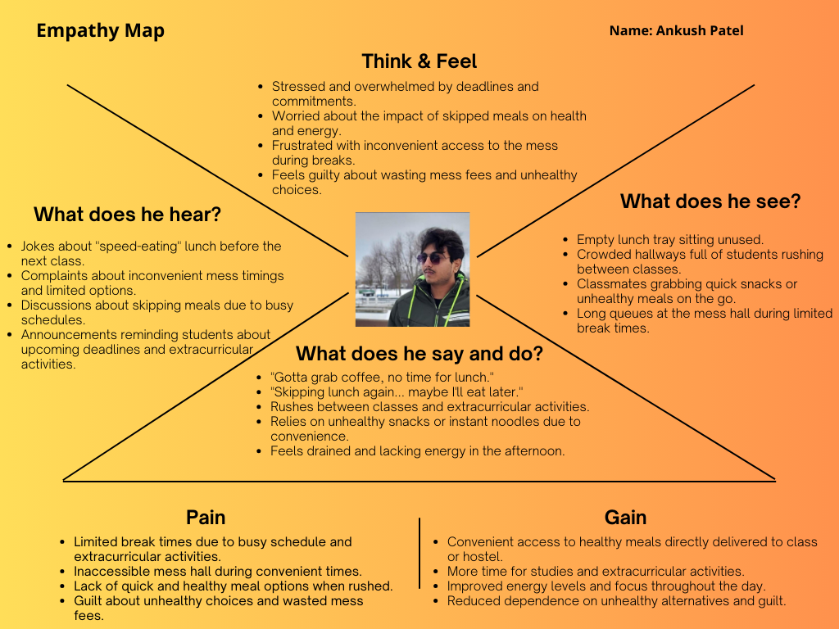
EMPATHY MAPPING

Slide 27
Insights and Inferences for LPU Orders:
Strengths:
Addresses a clear and pressing need: Busy schedules, long distances, and inflexible mess timings create significant inconvenience and food waste for LPU students.
Convenient and efficient solution: Ordering through the app and delivery to academic blocks/hostels saves time and eliminates the need for travel.
Improved accessibility and meal choices: Students gain access to wider menu options, catering to diverse preferences and dietary needs.
Potential for positive impact: Reduced food waste, improved student well-being, and increased campus engagement are all possible outcomes.
Scalability and replicability: The model can be adapted to other universities facing similar challenges.
Areas of Improvement:
App functionality and user experience: Ensure seamless ordering, tracking, and delivery processes. Prioritize user-friendliness and intuitiveness.
Food vendor and menu options: Secure partnerships with diverse food providers and offer a variety of healthy and appealing choices.
Delivery logistics and efficiency: Optimize delivery routes and personnel to ensure timely and reliable service. Consider sustainability aspects like eco-friendly packaging.
Marketing and user adoption: Effectively communicate the app's benefits and incentivize student usage through promotions and gamification.

Slide 28
CA-2

Slide 29
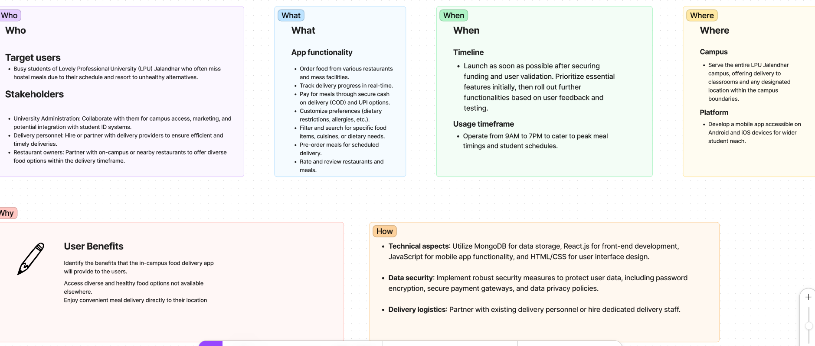
5 W’s and 1 H
https://www.figma.com/file/HljXRj9YTeXPLkiMYopVRI/LPU-GRUB'?type=design&node-id=0%3A1&mode=design&t=CMTCUGmP8DfGSyTS-1

Slide 30
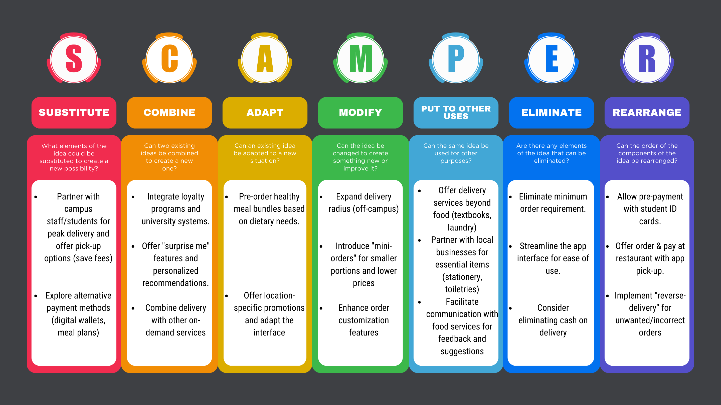
SCAMPER:

Slide 31
Scenario Building
Scenario 1: Sarishti’s Healthy Choice
Situation: Saristhi wakes up late and realizes she missed breakfast. She wants to eat a healthy lunch but the limited vegetarian options at the mess hall don't appeal to her.
Problem: Saristhi is concerned about the lack of variety and healthy options available at the mess hall, making it difficult for her to stick to her dietary preferences.
Solution: Saristhi opens the LPU Orders app and filters the menu for vegetarian options. She finds a delicious and healthy salad bowl at a nearby cafe and places an order, choosing delivery to her hostel room. Additionally, she uses the app's "customize" feature to remove an ingredient she dislikes.
Scenario 2: Ankush’s Rush Hour Hunger
Situation: Rajeev has a class ending at 1:15 PM and another starting at 1:45 PM. He realizes he didn't eat breakfast and feels hungry.
Problem: Due to the limited break time and distance from the mess hall, Rajeev usually skips lunch or grabs unhealthy snacks.
Solution: Rajeev opens the LPU Orders app on his phone, browses a diverse menu, and places an order for a healthy wrap and a fruit salad, selecting delivery to his next class building. He utilizes a promotional code offered by the app to save some money.

Slide 32
Scenario 3: Jyotiraditya’s Time Crunch
Situation: Jyotiraditya has a packed day with back-to-back classes and an important meeting afterward. He knows the mess hall will have long queues, and skipping lunch isn't an option due to an afternoon meeting.
Problem: Jyotiraditya struggles with time constraints and limited access to the mess hall during his schedule, often leading to unhealthy choices or missed meals.
Solution: Jyotiraditya pre-orders his lunch through the LPU Orders app the night before, selecting a quick and healthy bite-sized meal from a nearby restaurant and specifying delivery to his class building before his last class ends. He utilizes the app's "pre-order" feature to ensure his meal is ready upon arrival.
Outcome: Jyotiraditya avoids the queue and receives his timely meal delivery, allowing him to grab a quick and convenient bite before his meeting without sacrificing valuable time or compromising on his health.

Slide 33
Final Idea
LPUGrUb : An In-Campus Food Delivery App
Convenience:
Partner with shuttles/volunteers for peak delivery times.
Offer pick-up options at designated locations.
Streamline interface and eliminate minimum order requirement.
Personalization:
Implement loyalty programs and personalized recommendations.
Offer pre-order healthy bundles based on dietary preferences.
Adapt the interface based on user location and preferences.
Diverse Options:
Expand delivery radius to include off-campus restaurants.
Partner with local businesses beyond restaurants.
Explore delivery options for other campus needs (textbooks, laundry).
Security & Efficiency:
Pre-pay with student IDs for faster and more secure transactions.
Facilitate communication between students and campus providers.

Slide 34
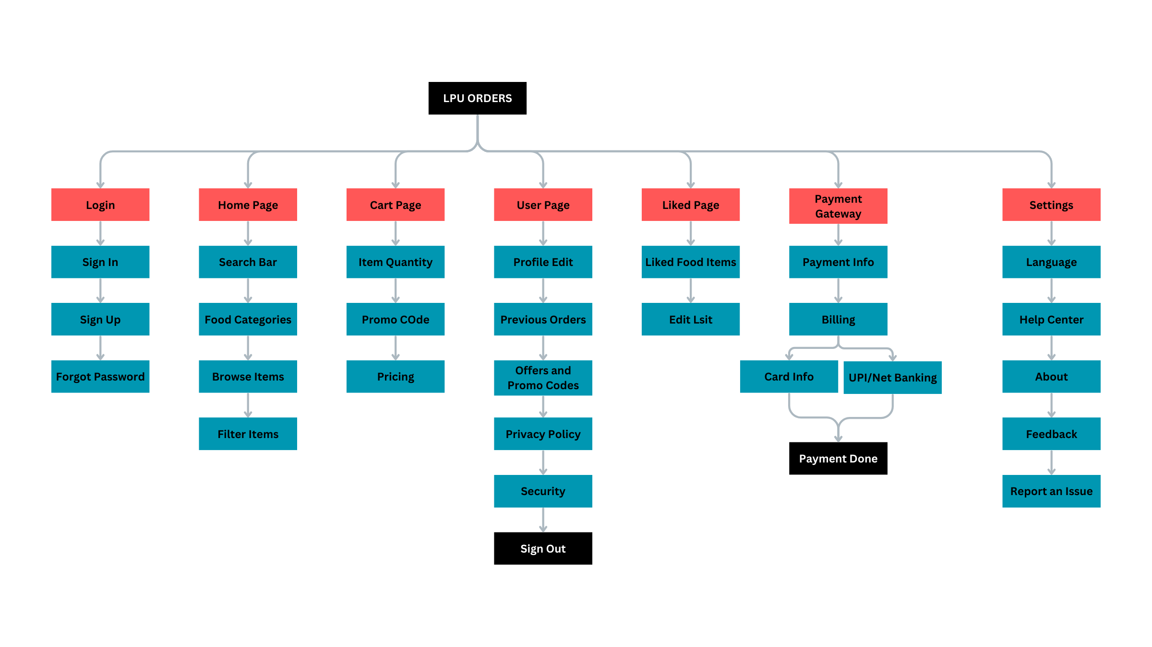
Information Architecture

Slide 35
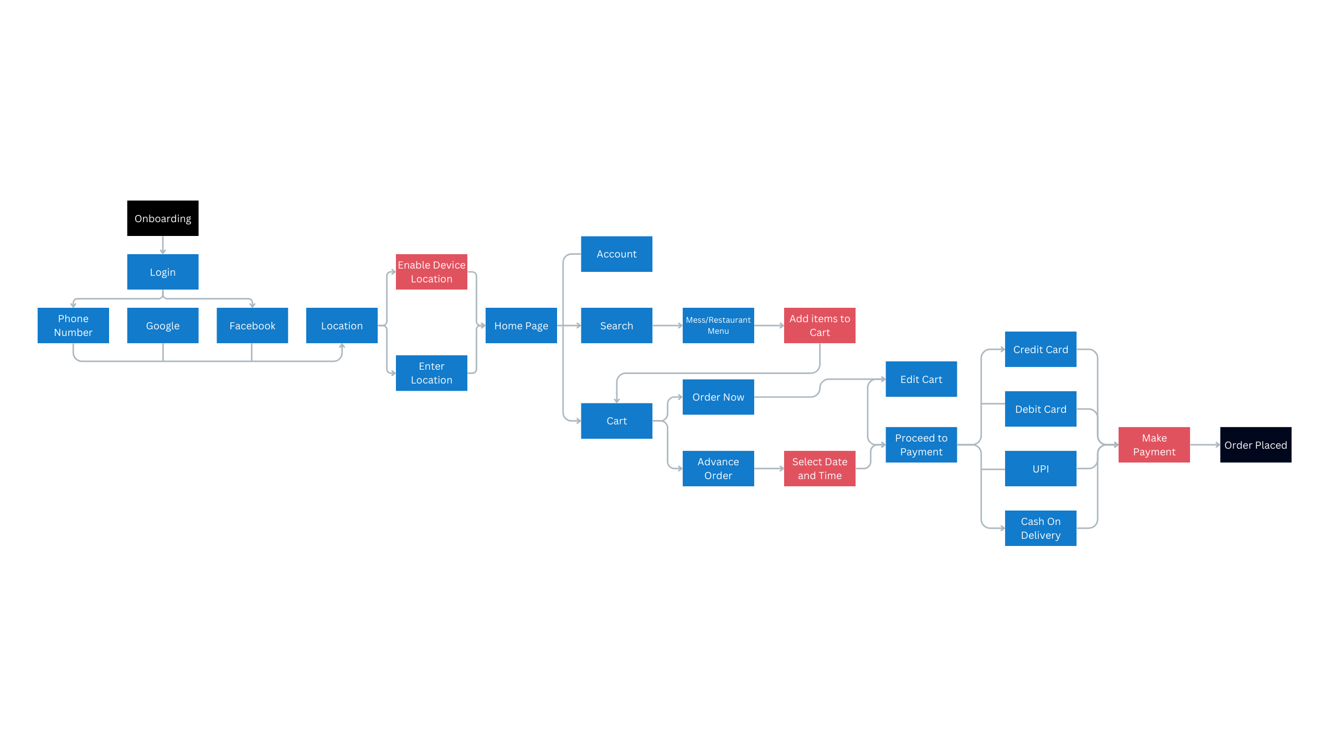
User Flow

Slide 36
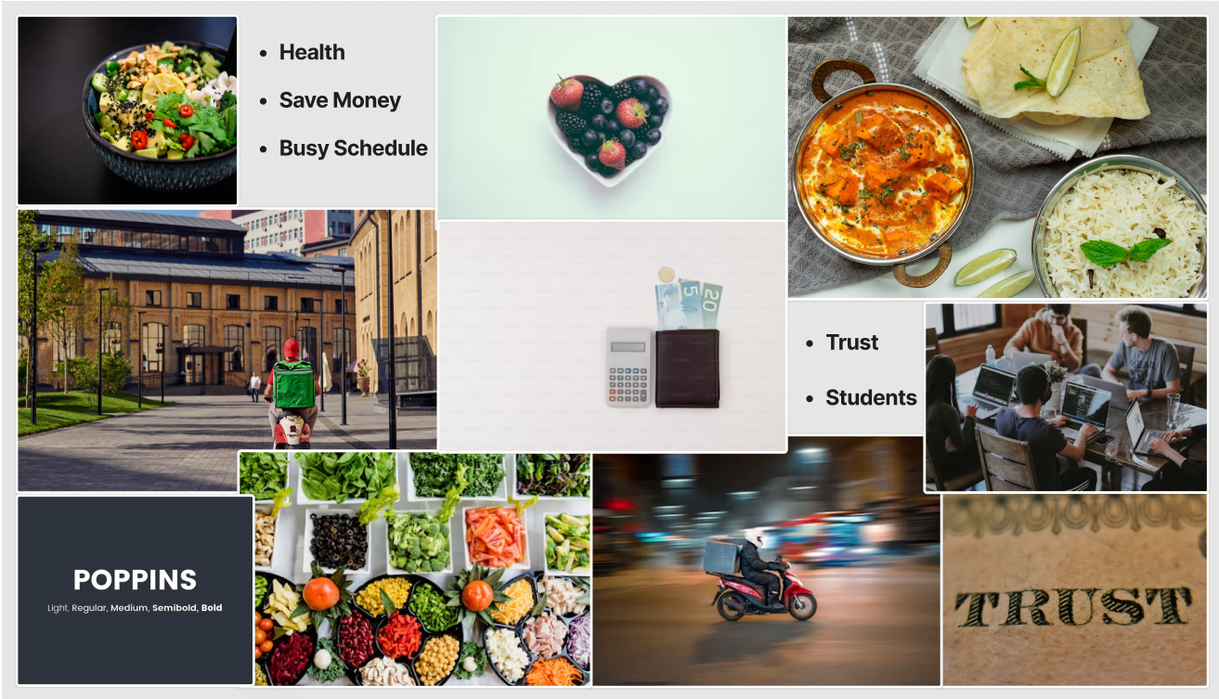
MoodBoard:

Slide 37
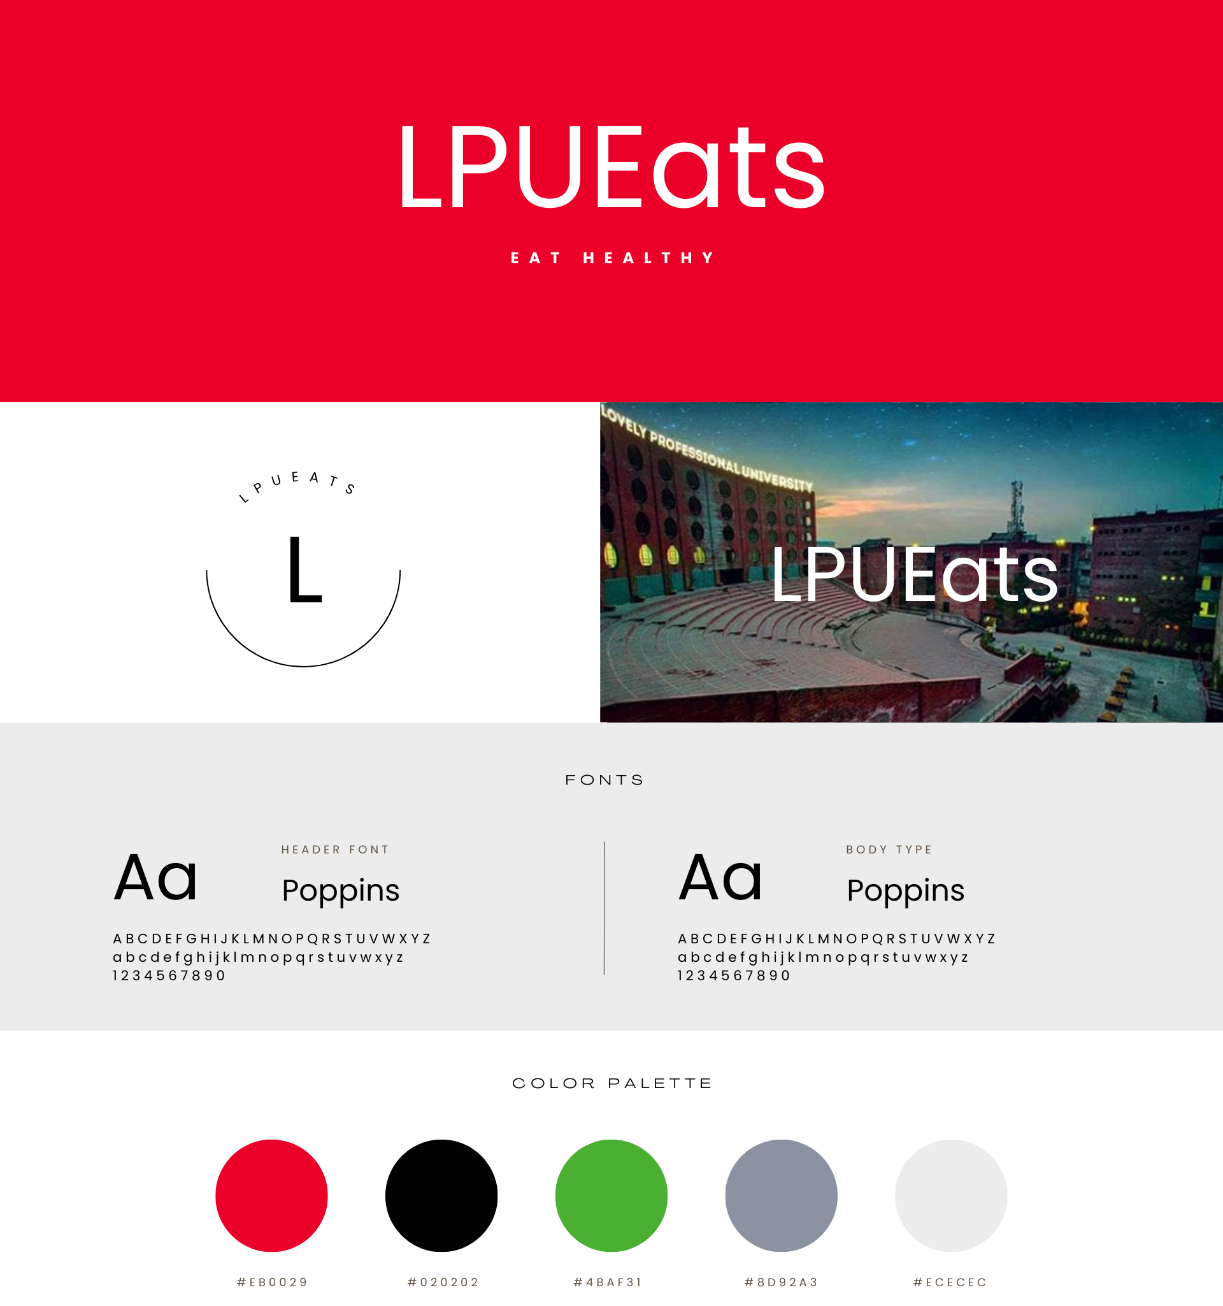
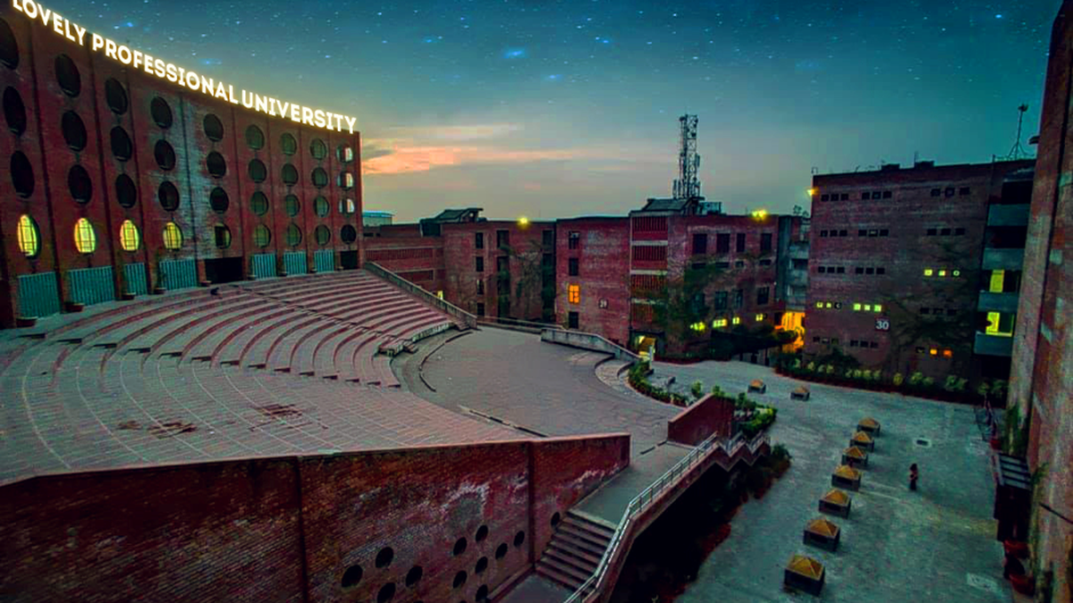
LPU GRUB
LPUGrub’
Style Guide
Creating a style guide for UI/UX is essential for maintaining consistency, usability, and a coherent visual identity across your project

Slide 38
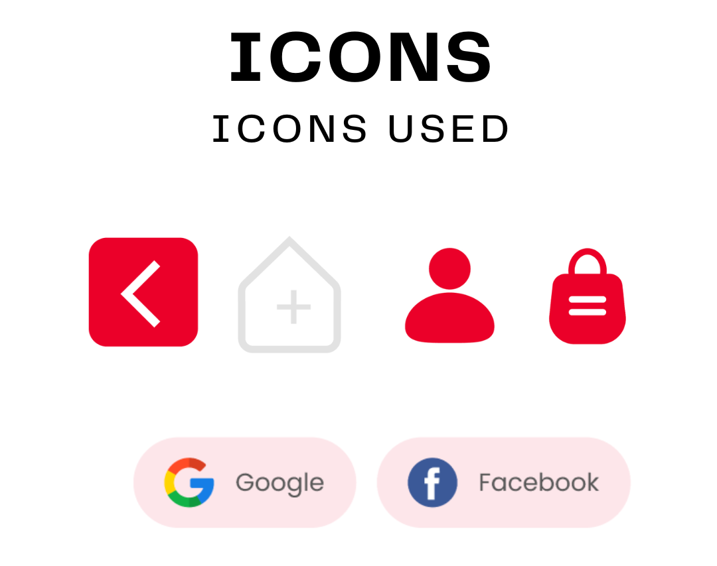
Style Guide

Slide 39
Figma Project LINKS
https://www.figma.com/design/HljXRj9YTeXPLkiMYopVRI/LPU-GRUB'?node-id=0-1&t=886OWlBKtf9Mij90-1
PROTOTYPE
https://www.figma.com/proto/HljXRj9YTeXPLkiMYopVRI/LPU-GRUB'?node-id=63-90&t=kjw9MYQur35A9AFb-1&scaling=min-zoom&content-scaling=fixed&page-id=0%3A1

